Slide 1
LLM Evaluation with MLFlow and DagsHub

Slide 2
LLM Evaluation Metric
Automatic Evaluation
Given supervised data how do we evaluate?
Run the model on the inputs to get predictions
Define a metric (or score) for model evaluation
Compute the metric
How to compute a score?
Human Evaluation
Automatic Evaluation
Task | Metric | Automatic Scoring Function
Classification | Accuracy | Exact Match:
Question Answering | Bert Score | How similar the semantic meaning?
Translation | ROUGE/BLUE | How many words common?

Slide 3
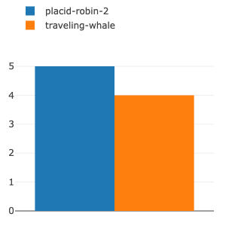
MLFlow DagsHUB
MLFlow Evaluation Metrics
exact-match
toxicity
ari_grade_level
ROUGE
Mlflow.metrics.genai.answer_relevance
Mlflow.metrics.genai.answer_correctness
Mlflow.metrics.genai.answer_relevance
Mlflow.metrics.genai.faithfulness
Compare Metrics between experiments

